Slide 1
Infinity Foundation
Leadership in content, methods, and mechanisms
The ONLY organization of its kind working in this field in a systematic, rigorous & consistent manner with a proven track record
Endowment
$6.5 million at the peak.
Declined to $3.5 million
Annual Budget
was $500,000
Now $150,000
400+ Grants Given
Totaling over
$5 million

Slide 2
About Infinity Foundation
Leadership in content, methods & mechanisms
Mapping the Kurukshetra
Evaluation of how other major nations control the discourse on their terms
Using Indian lens to study India & the world
Expertise provided to Hindu leaders, civic groups, think tanks
Funded books, reports, world conferences, academic chairs, activism

Slide 3
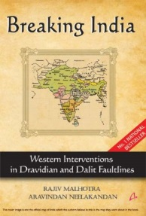
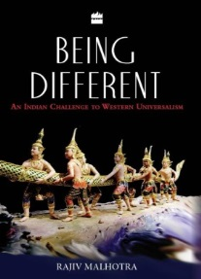

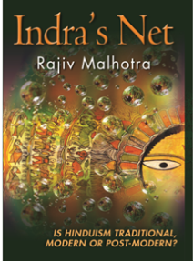
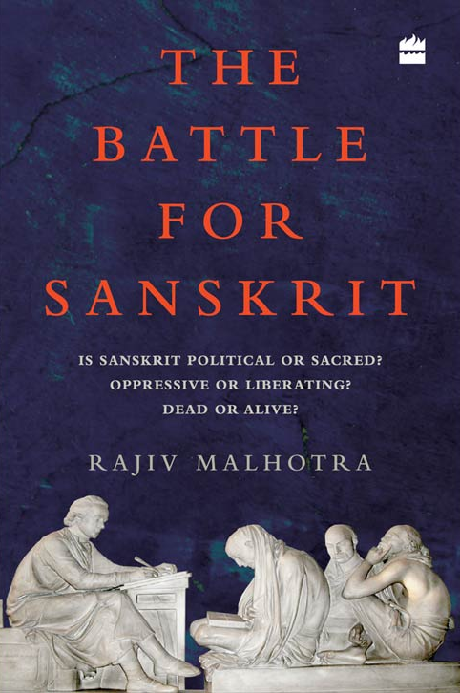
About Rajiv Malhotra
Contribution
Past Career
Purpose
Original thinker who identifies potential battlegrounds & assesses impact before they become apparent to others.
Senior corporate executive, strategic consultant & entrepreneur in IT/media.
Securing dharmic civilization & its place in the world.
Public Life
Education
Philanthropy
Author. TV commentator. Adviser to organizations.
St. Stephens College, then higher education in USA.
Retirement in 1994 at age 44 to pursue full-time philanthropy and research.

Slide 4

The Problem Breaking & Digesting Our Cultural Assets
COLONIZER
Denigration of Hindu Dharma
Digesting Our Cultural Assets
Controlling our Discourse
Depletion of India’s Brand
COLONIZED
Accepting Foreign Paradigms as Ours
Alienating Ourselves from Heritage
Inferiority Complex

Slide 5
Key Battlegrounds
Hindu sampradayas, temples, gurus
Hindu civic & political groups
Alienated, secularized Hindus
Sympathetic White “Hindus”
Media
Academic research
Think tanks; NGOs
Government policymakers
Education
Interfaith
Blatant opponents

Slide 6
Intellectuals’ Circle of Influence/Control
Schools
University research & Teaching
Next Generation Leaders
Scholarship & Teaching
Judeo-Christian Seminaries
Churches &
Home Groups
Intellectuals
EDUCATION
Journalism
Entertainment
Government
Foundations & Think Tanks
Policies & Laws
News; Discovery; History; National Geographic, etc.
Foreign & Domestic Interventions
Old Media & New Media
Inter-Faith Dialogs & Human Rights Interventions
Pop Culture
Lobbies, Activists, NGO’s

Slide 7
Value Chain of Knowledge about India
Knowledge Production
Distribution
Retailing
Academic Research and Think Tanks
Journals, Conferences, Academic Presses, Reports
Classrooms, Media
CONSUMPTION
(by students, media audience, public)

Slide 8
Knowledge Consumption Changes Worldview of Colonizer & the Colonized
West
COLONIZER
Government Agencies
Academy, Churches Etc..
American ‘Freedom’ Agenda => World’s Police creates…
A Sense of Moral Superiority, which feeds..
India
COLONIZED
Various Groups in India Portrayed as Underdog
Stimulates Political Activism
In turn Attracts $$ (from Colonizer) for funding Breaking India forces
Free Speech (eg: JNU)
Human Rights
Religious freedom
Women’s Rights
Minority Rights

Slide 9
Foreign Interventions that “break” India
Are India’s Fragments “Managed” by the West?
West
Funding Agencies
Academy
Churches
Government
India
Academy
Media
Funding
Hindu Sampradayas
NGO
Church
Subsidiaries

Slide 10
Hinduism Being Digested into Western Systems
DHARMA
MAINSTREAM AMERICANISM
FRINGE AMERICANISM
India based
Vedanta
New Age
Yoga
Secular
Funding
w
E
S
T
E
R
N
S
C
I
E
N
C
E
Transcendental
Meditation
US-Based
Indian
Gurus
I
N
D
I
V
I
D
U
A
L
S
Transpersonal
Psychology
A
M
E
R
I
C
A
N
Cognitive
Science /
Neuroscience
A
M
E
R
I
C
A
Yoga
Self
Improvement
Tantra
Wellness
Science
Goddess
Consciousness
Studies
C
H
R
I
S
T
I
A
N
Buddhism
Philosophy
of
Quantum
Mechanics
Philosophy
Of Science
J
U
D
E
O
Music/
Vegetarianism
Ecofeminism
Christian
Funding
Bhakti/
Kirtan

Slide 11
The Solution Three Pronged Response
DEFEND
Control the Discourse
Educate our people & boost confidence
DISRUPT
Expose the Bias
Reverse the Gaze
CONSTRUCT
Research & Publish
Develop Dharmic Solutions
Notes:
I Changed the order –

Slide 12
Infinity Foundation’s Positioning High-leverage interventions to change the discourse
Produce game-changing original research
Refute stereotypes / shatter ‘groupthink’
Educate Indian thought leaders:
Religious, political, industry, media
Strategic debating with outsiders & insiders
High leverage conferences
Training a kshatriya force & my successors
Trickle down the knowledge:
Online, video documentaries
College, school curriculum
Social media activism
ANCHORED IN MISSION
Improve India’s cultural capital and brand value

Slide 13
Glimpse of Our Sanskriti Revival Programs
Strategic Disruptions in the Intellectual Kurukshetra
Dharma and Mind Sciences
History of Indian Science & Technology
Re-imagining India & its influences on World Civilization
Mentoring & Training the Intellectual Kshatriyas
Influencing key thought leaders

Slide 14

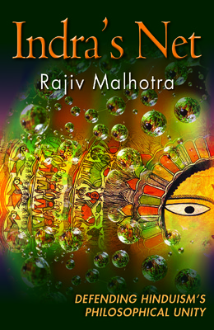
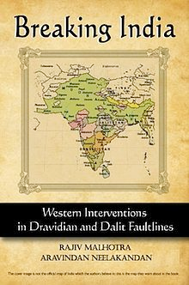
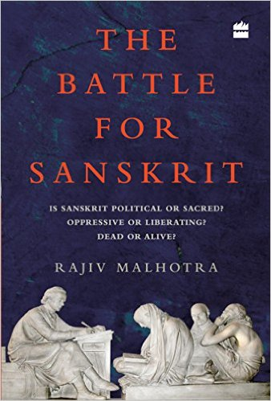

Sanskriti Revival Series-1
Strategic Disruptions in the Intellectual Kurukshetra
Media
Biases
Interfaith
Representation
Civil / Political
Representation
Direct confrontations with biased thinkers/media
Challenging Hindu representatives who sell out/compromise
Arguing with our own leaders’ misrepresentations
“Invading the Sacred”
Disrupted the academic nexuses
of Hinduphobia
“Indra’s Net”
Responding to academic charges of
internal contradictions and incoherence
“Breaking India”
Exposed nexuses threatening the
breakup of the civilizational backbone
“Battle for Sanskrit”
Exposing the Leftist Hijacking of our Sanskriti
“Being Different”
Explaining what is distinct that
we must not compromise
“U-Turn & Digestion Theory”
Uncovering the theft and plagiarism
on our Sanskriti across many areas
Future
...

Slide 15
Sanskriti Revival Series-2: Dharma and Mind Sciences
Identified Western appropriation of Hindu and Buddhist ideas & practices into psychology, cognitive sciences and neurosciences
Funded over 50 research projects to reposition dharma as mind science
Started series of academic conferences in India
Sponsored college textbook on Indian Psychology
Writing 3-volume set of books on “Indian Mind Sciences”:
Philosophy
Psychology & Clinical Therapies
Cognitive Sciences & Neurosciences

Slide 16
Sanskriti Revival Series-3: History of Indian Science & Technology
Civil Engineering, city building, architecture
Water management
Agriculture technology
Medicine
Metallurgy
Mathematics, astronomy
Ship building & shipping
Textiles

Slide 17
Sanskriti Revival Series-4: Reimagining India & its influences on World Civilization
Indian trade → leading to Columbus, etc.
Indian science & technology
Sanskrit → European languages; modern linguistics
Impact on modern popular culture: music, literature
Spirituality, yoga, meditation, fashion, cuisine, vegetarianism
Ayurveda, mind-body healing
Ecology
Philosophy
Christianity

Slide 18
Sanskriti Revival Series-5: Mentoring & Training the Intellectual Kshatriyas
Simplified materials for mass consumption:
Summaries
Youth toolkits for debates
Youtube
Documentaries
Online discussions, video conferences
Social media campaigns
Education system materials
Indian language editions
Leadership training workshops
“Live” training in real encounters; public speaking

Slide 19
Sanskriti Revival Series-6: Influencing the leaders of key institutions
Hindu Dharma Acharya Sabha
Individual gurus
Academic professors & college students
Writers, intellectuals
Media
Political leaders
Industrialists & businessmen

Slide 20
Three kinds of development needed
Intellectual content: Research based. Tested in the kurukshetra:
Game changing ➔ must be non-ignorable
Provocative, risky ➔ controversial enough to disrupt the status quo
Creative, original ➔ best done outside big institutions
Human resource (Intellectual Kshatriyas): Individuals and teams trained in ‘A’, who evangelize thru many channels.
Institutionalization: To provide a force multiplier and continuity for ‘A’ and ‘B’.
Our focus is ‘A’: The biggest gap & leverage point. Our greatest strength. Already serving as consultant to gurus, politicians, educationists.

Slide 21
Focus: Developing Hindu Intellectual Kshatriyas
Waking the Hindu Diaspora
Disrupting the Pseudo Intellectuals
Defining Our World View
Campaigning the Gurus to Engage
Social Media to Counter Old Media
Academic Chairs and Conferences

Slide 22
Constraints we face Resource & Priority Conflicts
Original research to disrupt prevailing paradigms
Disseminate knowledge
Train successors / Army of intellectual Kshatriyas
Cannot afford to do all this within current financial constraints

Slide 23
Immediate Funding Needs
1
2
3
Targeted book distribution
R&D for new books
Book translations
4
5
6
Documentaries
Training workshops for next-gen leaders
General Fund at our discretion

Slide 24
Proposal
Strategic Intervention to Improve India’s Cultural Capital and Brand Value
Institutionalization, Succession Planning and Transition to Home Team
Finish Path Breaking Research
Develop and Deliver Training to Build Dharma Home Team
Transform Research into Simpler Products
High dependence personal time of Rajiv M
Focus on strategic interventions – path breaking research
15+ additional books / issues at various stages of completion
Smaller context specific books for easier absorption
Documentaries for strategic topics
Plan education materials development for public as well as for formal adoption in education curriculum
Develop training material for specific audience (Universities, Ashrams, Government, Corporate)
Deliver classroom training (home team identification)
Develop & launch LMS enabled online multi-media training for broader audience
Budget Estimate: $3M over 3 Years
Output is scalable depending upon funding level

Slide 25
Kshatriya Academy (similar to Khan Academy)
Build a cloud platform
Disseminate our simplified content
Help others assimilate the content into:
School textbooks
Bal vihars
IAS/IPS/IFS training
Political leadership & youth training
Training of media, film making, theater…
NGOs ideology

